Slide 1
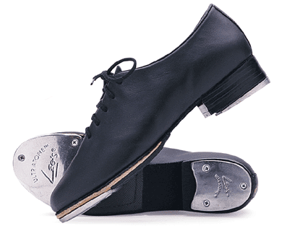
Tap Dancing
By. Nikki Almasi & Ashley Chamberlain

Slide 2
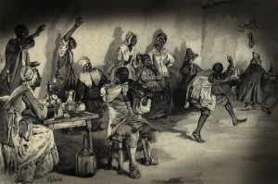
Origin
Tap Dancing started back in the early 19th century.
It is believed to have been based from African dance movements and was brought to America by slaves in the Southern United States.
African slaves began tapping after being prohibited by the slave masters due to the language of the drums.
It melded with Irish and British clogging steps to form tap dancing.

Slide 3
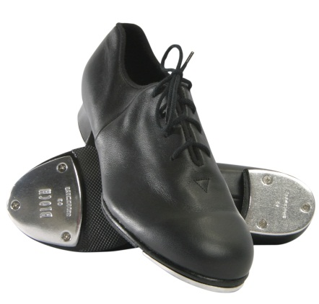
Style
Tap dancers wear special shoes equipped with metal taps.
Tap dancers use their feet like drums to create rhythmic patterns and timely beats.
A few of the basic tap steps include the brush, flap, shuffle, and ball change.
The goal in tap dancing is to produce clear, clean sounds, with various levels of tone. Body weight should be held slightly forward, allowing most of the dancing to be done on the balls of the feet. The knees and ankles should be relaxed at all times

Slide 4
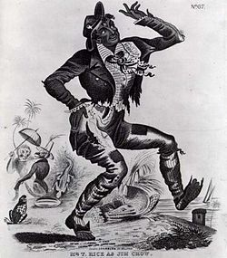
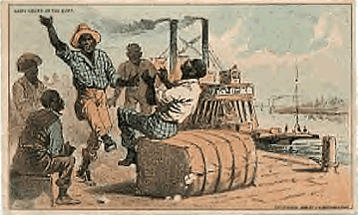
Evolution of Tap
Tap dance came from West African and British Isles Dancing.
African slaves, had been transported to America during the 17th and 18th centuries.
They started dancing because drums were prohibited. Drums were replaced with foot tapping and clapping
Their previous dance movements had to be modified into low shuffles, sweeps and stomps.

Slide 5
Tap Dancing's Popularity and Fame.
Tap became famous from being seen in Broadway shows.
In the 1820’s tap dance was finally evolved into stage dance.
In the 20th century tap intertwined with jazz and blues music.
During the early 1900’s tap became popular on broadways, in film and in musicals.
Jazz music spread in the 1920’s and Tapping came along in shows.
Tap dancing’s popularity died down in the 1960s and 70s,but came back in the late 70’s and early 80’s.

Slide 6
Video
http://www.youtube.com/watch?v=P4x12uMeVVc

Slide 7
Bibliography
"Where did tap dancing originate from - Ask.com." Ask.com - What's Your Question?. N.p., n.d. Web. 23 May 2013. <http://www.ask.com/question/where-did-tap-dancing-originate-from>.
Category. "Tap Dance - Learn How to Tap Dance." About Dance - Learn to Dance - Dance Steps and Tips - Ballet and Jazz Dance . N.p., n.d. Web. 23 May 2013. <http://dance.about.com/od/typesofdance/
Masters, Denise. "Tap dance history." Upload & Share PowerPoint presentations and documents. N.p., n.d. Web. 27 May 2013. <http://www.slideshare.net/dmasters/tap-dance-history>.
"An Absolutely Amazing (and Adorable) 7-Year-Old Tap Dancer - YouTube." YouTube. N.p., n.d. Web. 29 May 2013. <http://www.youtube.com/watch?v=P4x12uMeVVc>.
"The history of… tap dancing. (Really.) | Simple Mom." Simple Mom | Live intentionally.. N.p., n.d. Web. 27 May 2013. <http://simplemom.net/history-of-tap-dancing/>.

